Slide 1
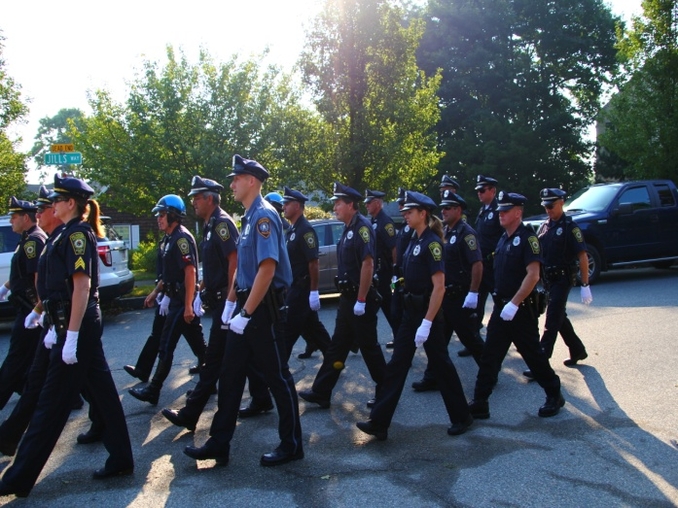
Digital/social media and its contribution to law enforcement

Slide 2
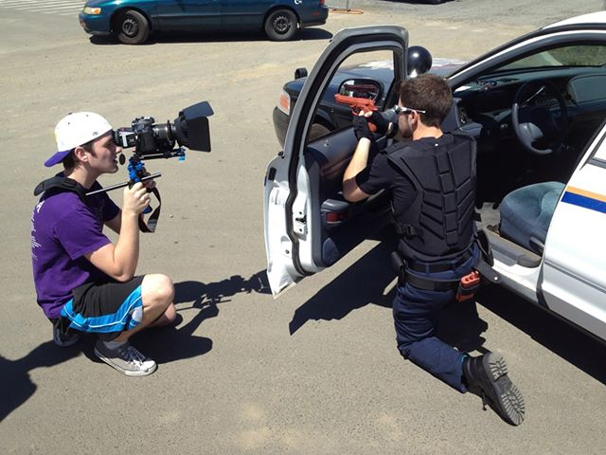
DIGITAL MEDIA/VIDEO
Digital media utilizes technology like websites, webcasts, blogs, podcasts , digital videos and social media sites to help spread the message of the department to the general public as well as develop and maintain relationships with reporters, community members and government officials.

Slide 3
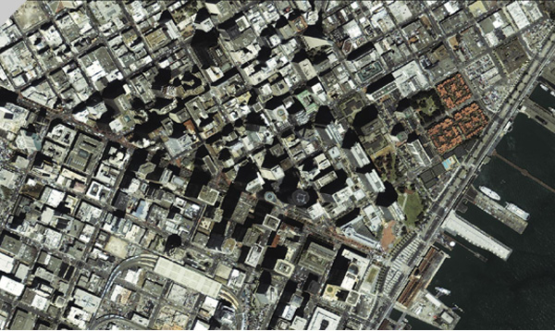
Utilizing Digital Media
The purpose for any law enforcement agency to utilize Digital Media is the same as any business or corporation, just as a business or corporation must have OPEN COMMUNICATION with its clients; a law enforcement agency must have OPEN COMMUNICATION with its public.
The public can prove quite useful to the agency or department in ways of acquiring information in certain cases and the department can prove quite useful to the public when it comes to obtaining general information as well. Digital media can help strengthen this bridge of communication.
Digital media and video is an excellent way to convey a message to your audience, and for law enforcement, this audience would be their general public. These messages can be messages of safety such as Public service announcements against drunk driving or texting and driving for example.

Slide 4
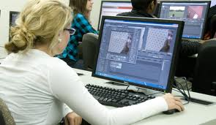
Media Relations Specialist
It is the job of the Media Relations Specialist to establish an Internet presence for public relations campaigns.
In general, the Media Relations Specialists develop and maintain relationships with reporters, community members, and government officials, as well as continue to establish and strengthen an ongoing relationship between the community and the police department.
Media Relations Specialists do the majority of their work online, using technology like websites, webcasts, blogs, podcasts as well as social media sites to help spread the message of the department to the general public.

Slide 5
UTILIZING SOCIAL MEDIA
Popular social media sites such as Facebook, Twitter , Youtube and Vimeo can be utilized as tools to build a better bridge of communication with the general public as well as help build a better understanding with the youth who more predominately frequent social media sites such as the aforementioned ones. These socialmedia/ digital media sites can be uplinked to department or agency websites making it simple to access source material and will also take up much less storage space on your website.

Slide 6
WHO USES SOCIAL MEDIA?
According to a study done by Pew Research Center, 65% of adult internet users use social media networking sites.
According to Wireless RERC 63% of people with disabilities use social media .
Usage for all age groups has been increasing throughout the years. The highest percentage of social media users are currently in the 18-29 age groups.

Slide 7
Attributes and Objectives of Social Media
Get the message out faster
Reach more people through other communication channel .
Relatively low operating costs
Reach people via mobile devices
Instant, high scalable form of communication
Direct from the source

Slide 8
Growing Group of Interested Stakeholders
SOCIAL MEDIA
LOCAL BUSINESSES
GENERAL PUBLIC
OTHER DEPARTMENTS AND AGENCIES
MEDIA
LOCAL AND NATIONAL GOVERNMENT
COMMUNITY BASED ORGANIZATIONS

Slide 9
Behind the thin blue line
RISING ABOVE. GOING BEYOND.

Slide 10
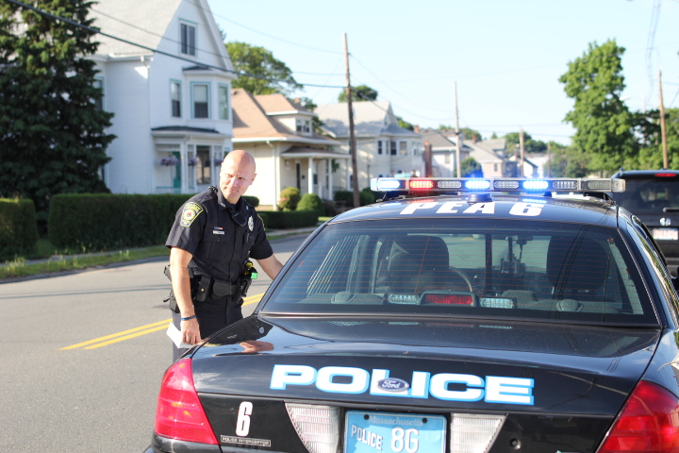
BEHIND THE THIN BLUE LINE
Behind The Thin Blue Line is an informative law enforcement show done in a talk show format, it not only showcases the inner workings of modern law enforcement but also educates the public about how modern law enforcement.

